Slide 1
Hybrid Encoder Implemenation

Slide 2
Why CNN + Transformer?
CNN
Captures local forensic traces and texture artifacts.
Efficient feature extraction with strong inductive biases.
Transformer
Models long-range dependencies.
Links distant image patches.
Aggregates global semantic context.
Motivation
Forgery detection may require both local evidence and global consistency.

Slide 3
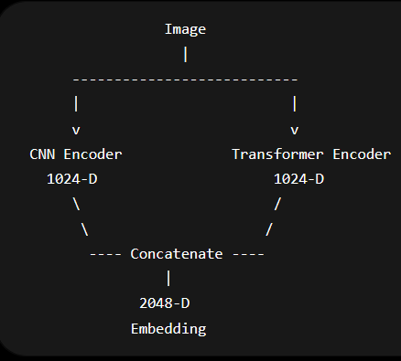
Original Architecture Idea

Slide 4
Why Pivot to Conv Transformer?
Convolutional Vision Transformers already embody the CNN + Transformer philosophy.
Use CNNs to extract informative local features.
Allow transformers to reason over those features.
Easier baseline before exploring novel dual-encoder designs.

Slide 5
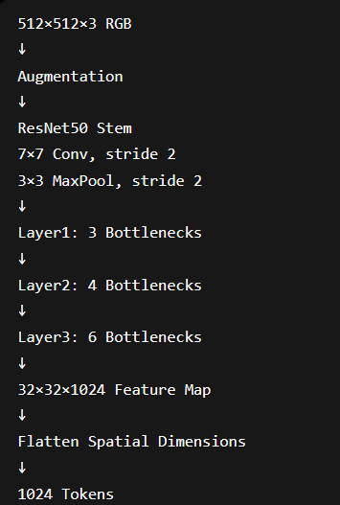
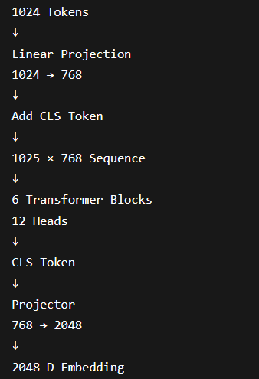
Full CvT Pipeline

Slide 6
Data Pipeline
Positive (Benign)
Gaussian blur
Box blur
Motion blur
Noise
Brightness scaling
Negative (Forgery)
Random local region
Heavy Gaussian blur (Or a watermark, suggester later by JP)
Feathered blending
Tamper size increased later

Slide 7
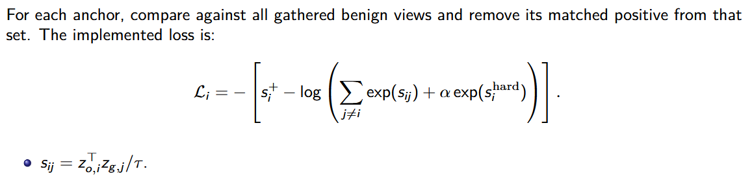
Contrastive Objective
Anchor: Real Image
Positive: Benign Transformation
Negative: Locally Tampered Image

Slide 8
Epoch 183 Statistics
(the statistics.txt file)

Slide 9
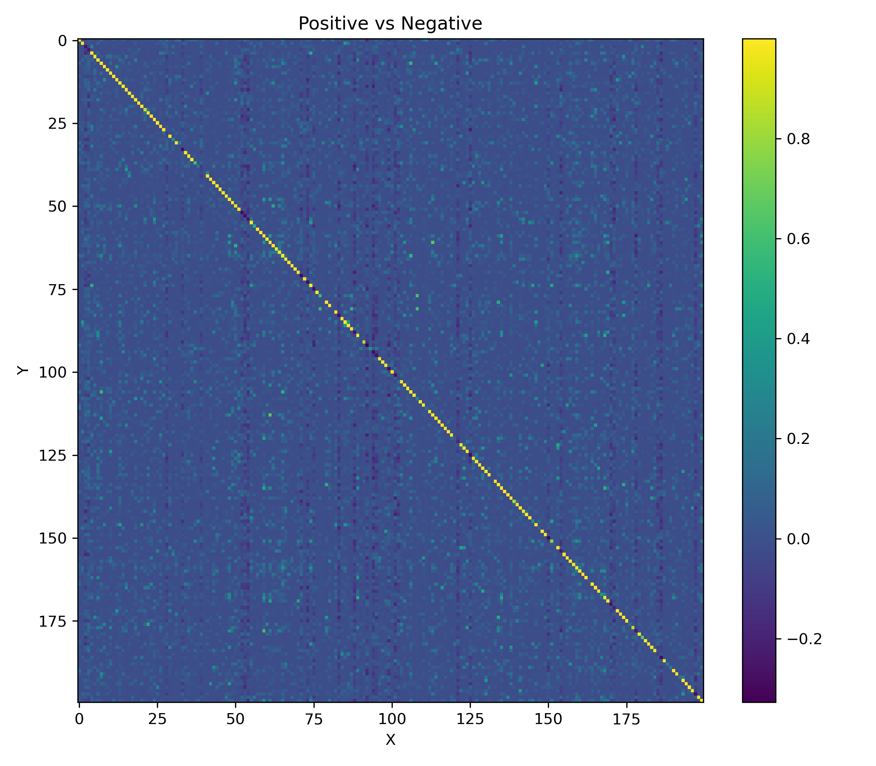
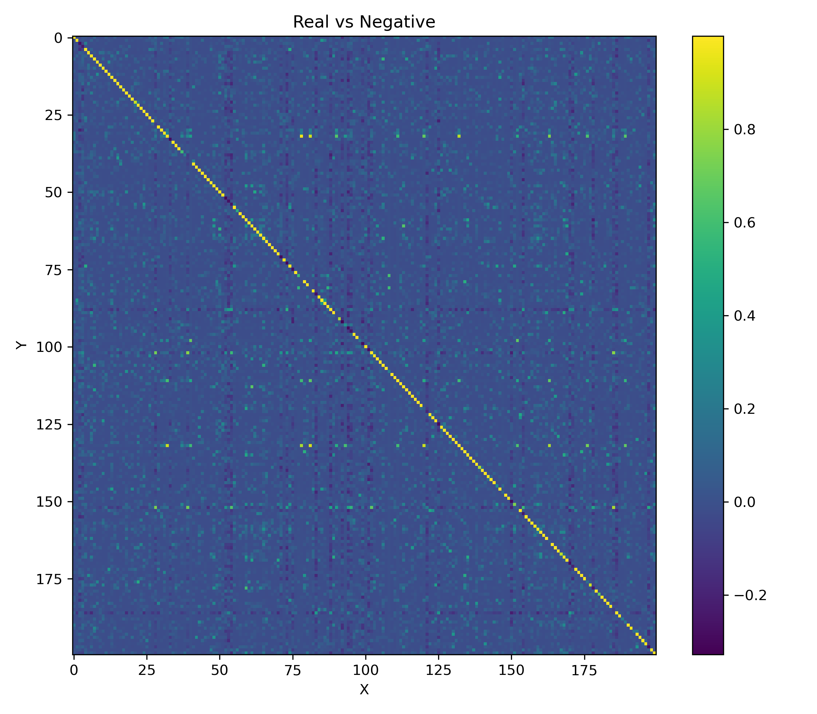
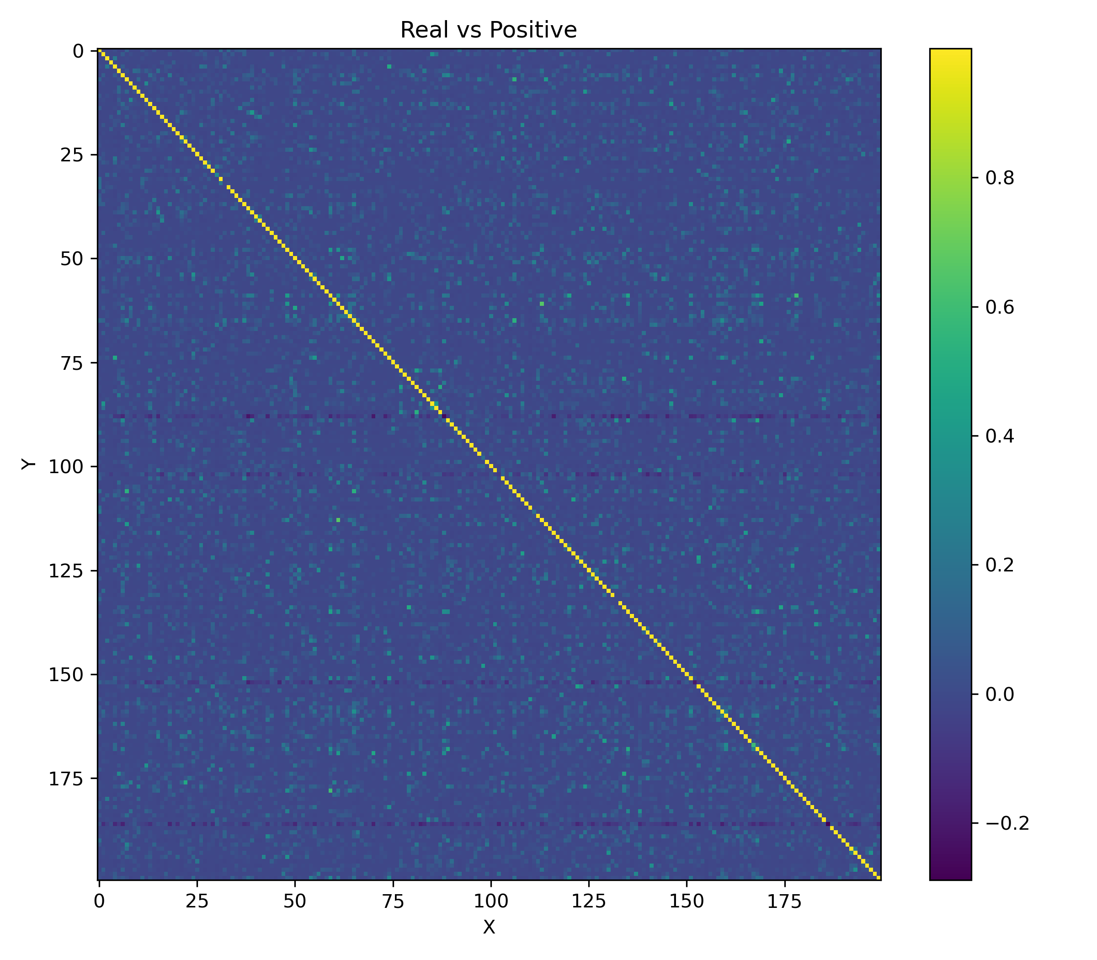
Heatmaps

Slide 10
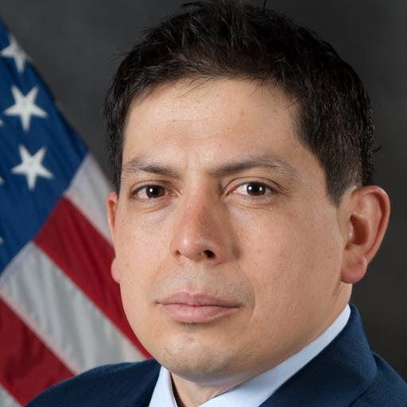


Worst Image comparision: 010 -> 1.000000 (Order: RPN)

Slide 11


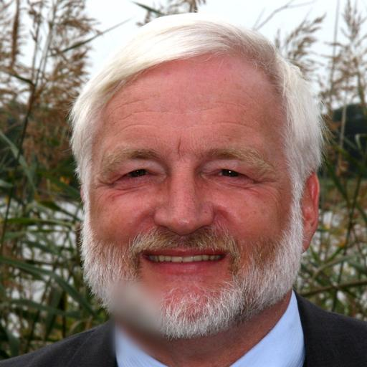
146 -> 1.000000

Slide 12
Failure Analysis
Observations:
Hard negatives often corresponded to blur landing on walls/backgrounds.
Low-information regions produced ambiguous negatives.
Model learned semantic invariance better than hard-negative separation.

Slide 13
GPU Profiling
Parameters are tiny (~0.2 GB). Activations dominate memory usage.
GPU Usage on A100:
Batch/GPU | Memory
48 | 44.6 GB
64 | 59.1 GB
92 | 77.1 GB

Slide 14
Future Work
Revisit dual-encoder architecture.
Watermark negatives.
Separate temperatures.
ResNet baseline.
SSM exploration.

